Slide 1
Logistic regression

Slide 2
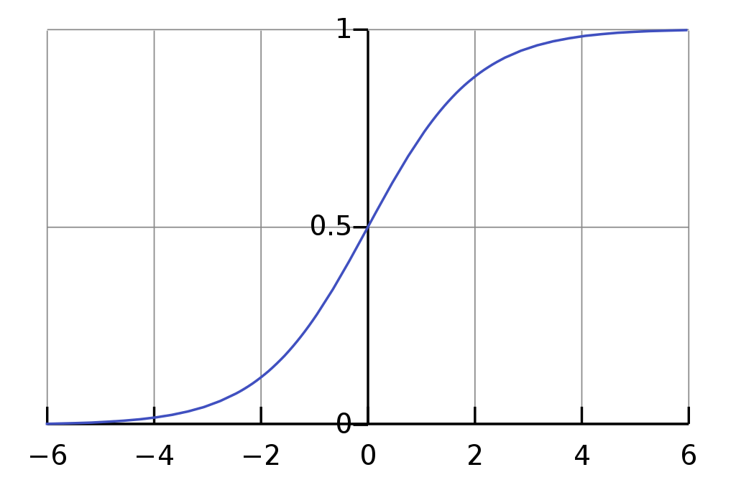
Logistic regression is a machine learning classification algorithm that is used to predict the probability of certain classes based on some dependent variables.
The output of logistic regression is always between (0, and 1), which is suitable for a binary classification task
Logistic regression use sigmoid function to classify categories, A sigmoid function is a mathematical function having a characteristic "S"-shaped curve or sigmoid curve.

Slide 3
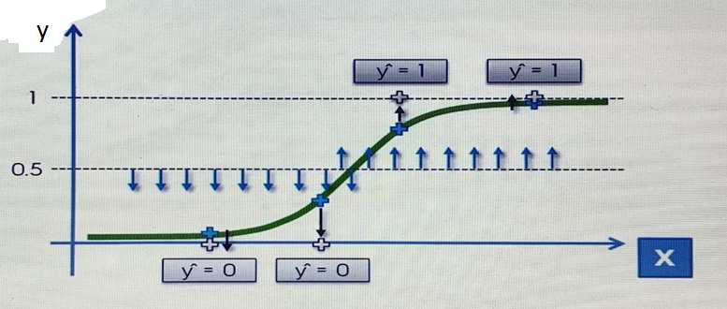
Working of Logistic regression
Working of logistic regression is batter understand by the consider the example of dataset of cancer patients here different size of tumor is given and base of size we are trying to classify the person with particular size have cancer or not.
Base of size and logistic regression will plot sigmoid function curve and output of sigmoid function is greater than or equal to 0.5 it will classify it as class=1 person having cancer. For output of sigmoid function less than 0.5 it will classify it as class =0 person not having cancer.

